Slide 1
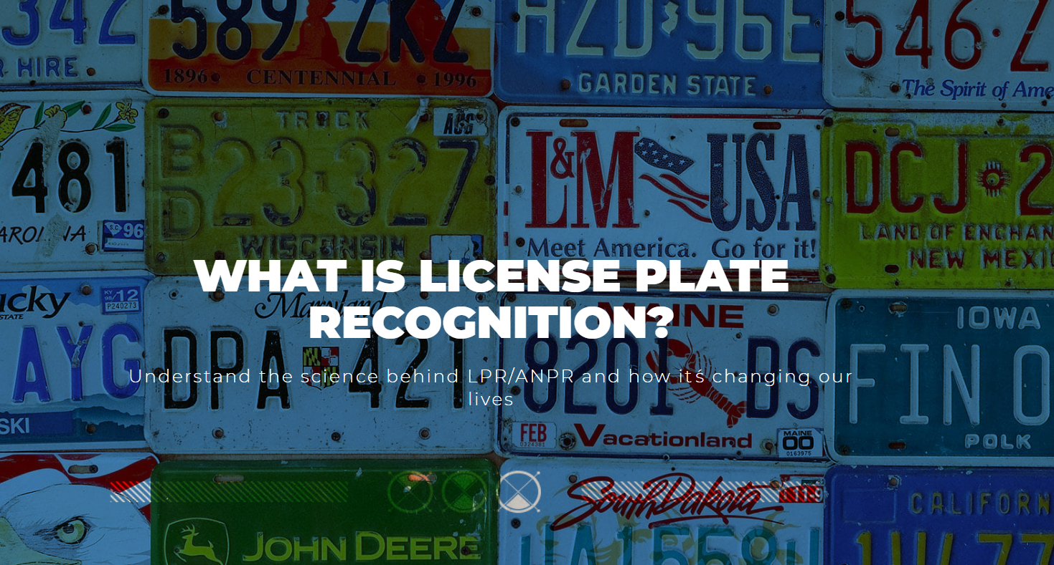

Slide 2
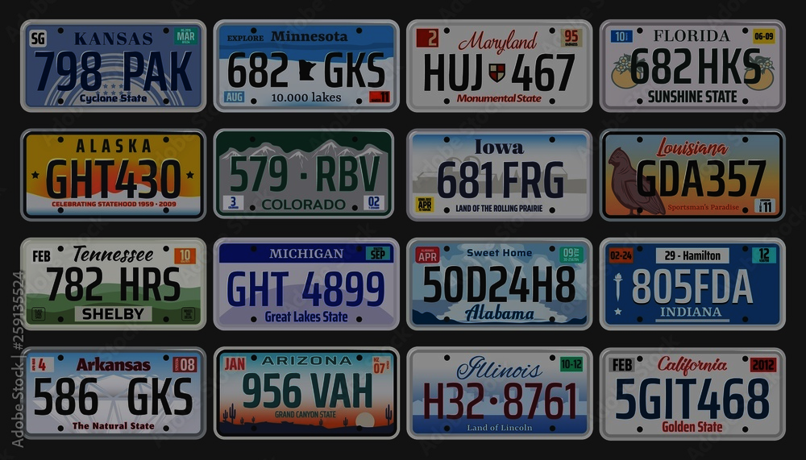
License plate Recognition (LPR) is the capacity to capture photographic video or images from license plates and transform the optical data into digital information in real-time.
Also known as Automatic Number Plate Recognition (ANPR), LPR is a widely used technology for vehicle management operations such as Ticketless Parking (off-street and on-street), Tolling, ITS, stolen vehicles detection, smart billing and many other applications in Europe and becoming a trend in the Americas.
By bringing the license plate digital information (among other data such as vehicle's direction and speed) to the mix, License Plate Recognition allows operators to immediately gather and associate more data about every vehicle passing a control point:
The action itself: time, place, direction and speed of the vehicle
The vehicle: origin, Restrictions or security alerts
The driver: License number, personal public or contact information about the driver

Slide 3
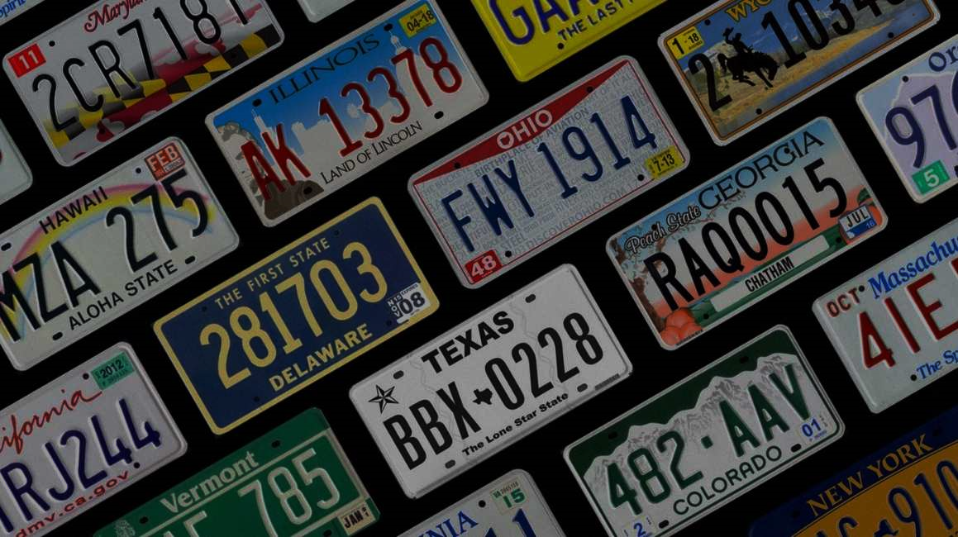
Thanks to License plate Recognition, operators have developed pretty "futuristic" solutions:
Imagine to be automatically billed at a tolling without slowing down, or parking in a mall without stopping at barriers to get in / out or at cashiers to pay; amazing? how about this: imagine a city that "knows" where every stolen or reported vehicle is, at any time.

Slide 4
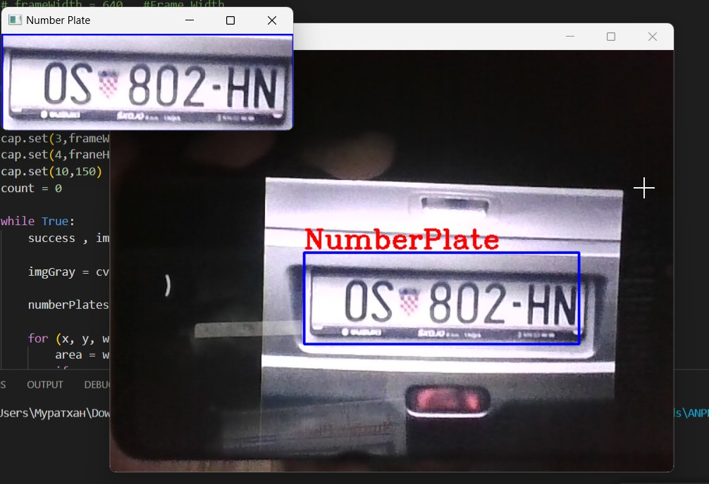
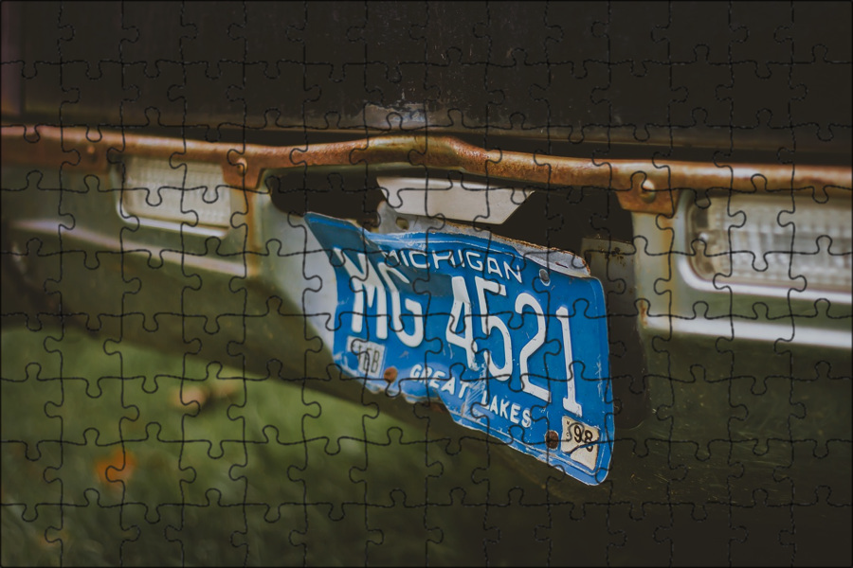
How does License Plate
Recognition work?
Once the LPR camera has captured the license plate image, its firmware uses license plate specialized OCR routines to translate it into digital (machine-readable) characters.
But License Plates are (very) different from each other; the characters don't look the same, not even close!

Slide 5
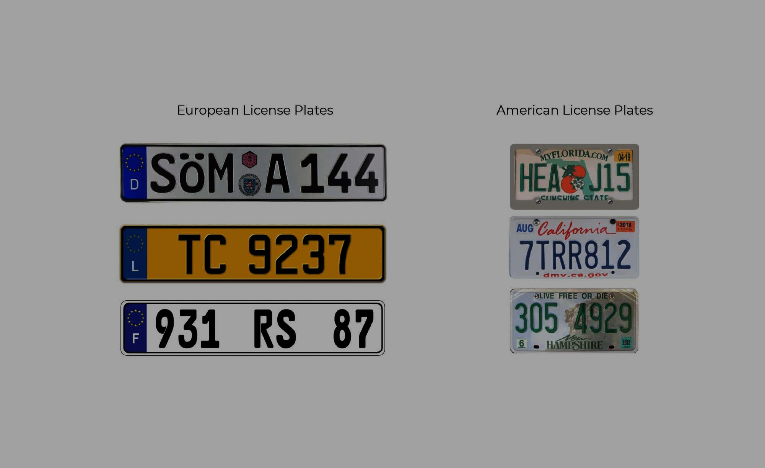
To recognize a license plate correctly, we have to "teach" the algorithm to read different plate designs from different types of license plates; what may seem like an O in some plates looks like a 0 in others.
So LPR is about knowing each possible plate variation and reading the characters according to many regional modifications; the algorithm needs to know "what to expect."

Slide 6
# Функция проверки казахстанского номера
def is_valid_kz_plate(plate_text):
plate_pattern = r'^\d{3}[A-Za-z]{3}\d{2}$' # Пример паттерна для KZ номеров
return bool(re.match(plate_pattern, plate_text))

Slide 7
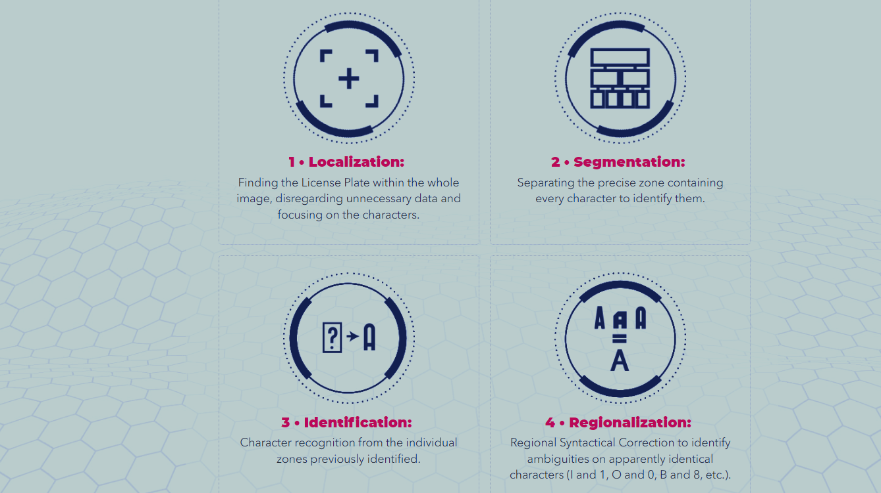
License Plate Recognition Phases
Although it may seem instantaneous (We at survision do it all in less than 20ms), License Plate Recognition is a 4 stage process; the first 2 are standard OCR, but the complicated part that makes LPR different than regular OCR comes at phase 3 and 4.

Slide 8



Overview of the Haarcascade Algorithm
Haar Features
1
Simple rectangular features that represent different shapes and patterns in images.
Cascade Classifier
2
A series of increasingly complex Haar features used to identify specific objects in images.
Classification
3
The classifier determines the likelihood of the presence of the target object (license plate) in an image.

Slide 9
Cascade Classifiers: Fundamentals
Feature Extraction
1
The Haarcascade algorithm extracts features from the image by comparing the sum of pixel values within different rectangular regions.
Training Data
2
A large dataset of positive and negative examples is used to train the classifier.
Feature Selection
3
The algorithm selects the most informative features that effectively discriminate between the target object and other objects in the image.

Slide 10
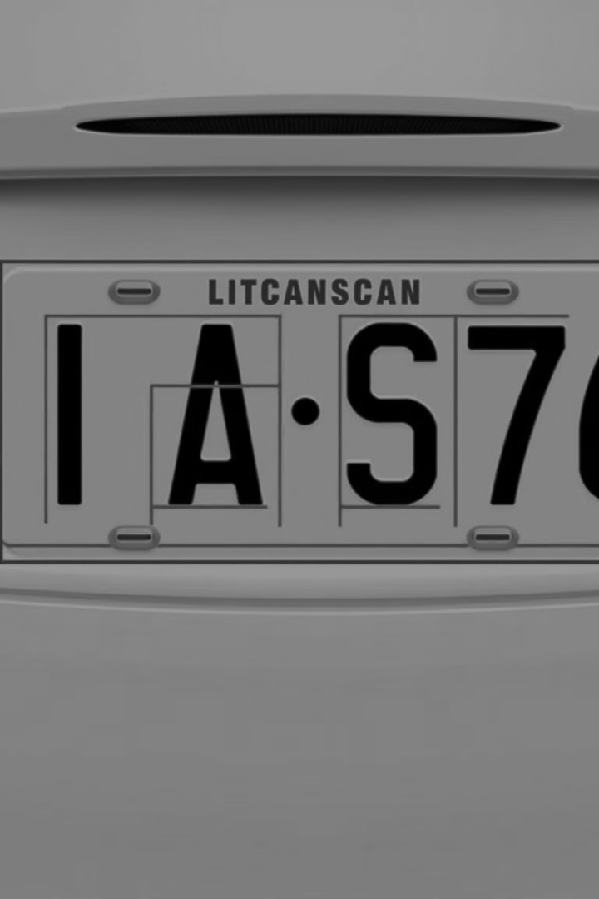
Feature Extraction and Classification
Image Preprocessing: Image enhancement, noise reduction, and grayscale conversion.
License Plate Detection: Identifying potential license plate regions within the image.
Character Segmentation: Isolating individual characters from the license plate.
Character Recognition: Classifying each character based on its shape and features.

Slide 11
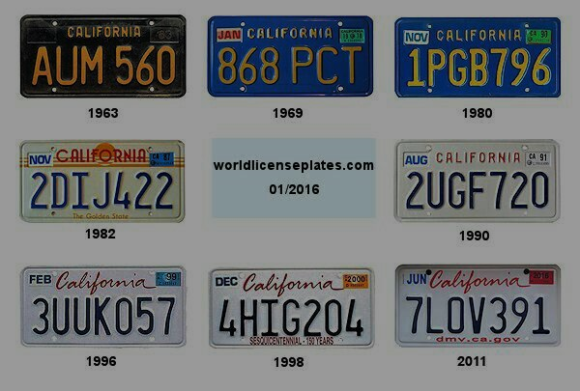
Challenges and Limitations of ALPR
Obstructed Plates
Lighting Conditions
Variable Plate Formats
Partially obscured or dirty license plates can make recognition difficult.
Poor lighting, such as shadows or glare, can hinder the detection process.
Different countries and regions use different license plate formats, making generalization challenging.

Slide 12
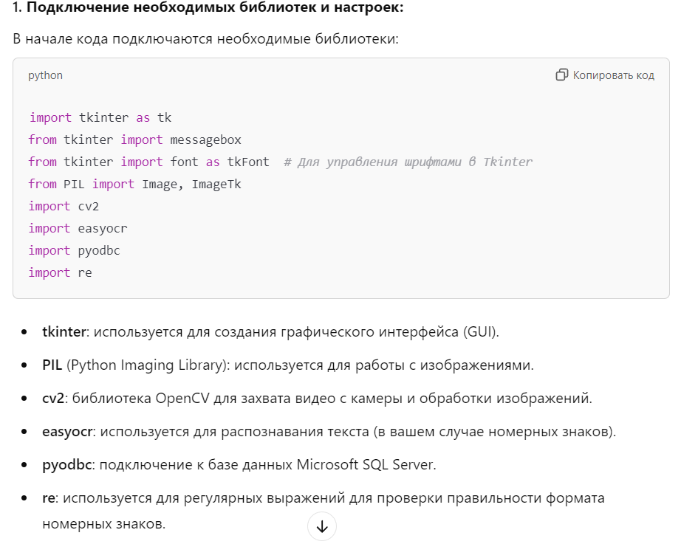

Slide 13
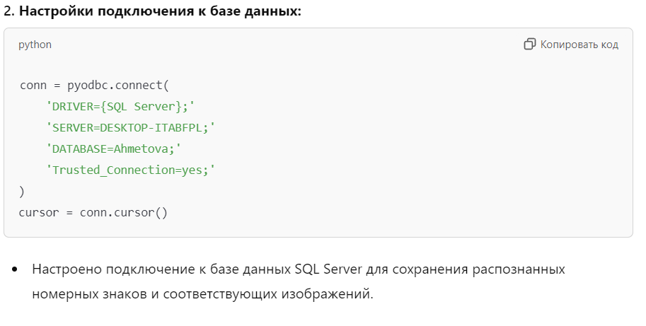

Slide 14
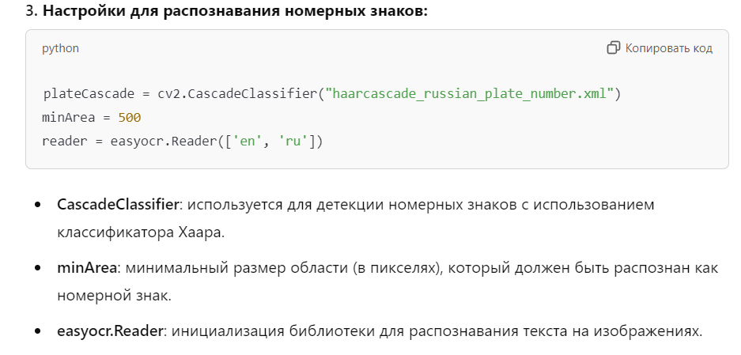

Slide 15
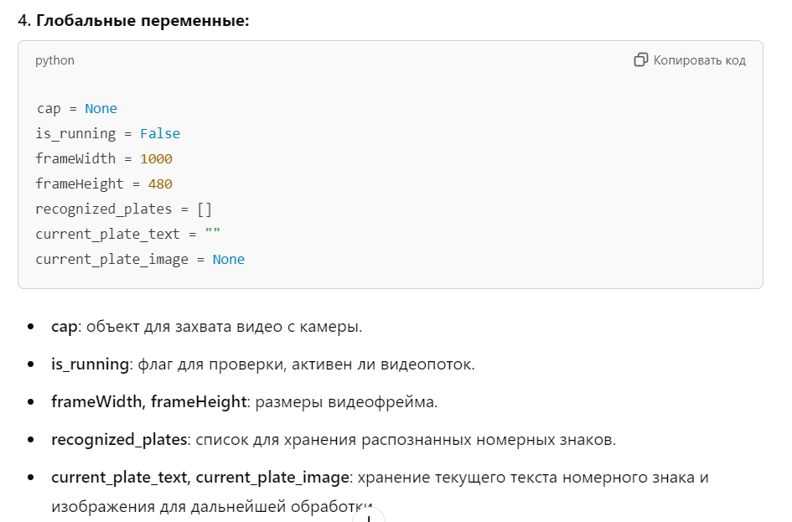

Slide 16
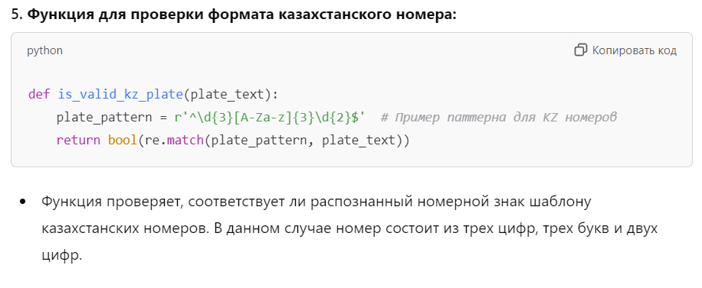

Slide 17
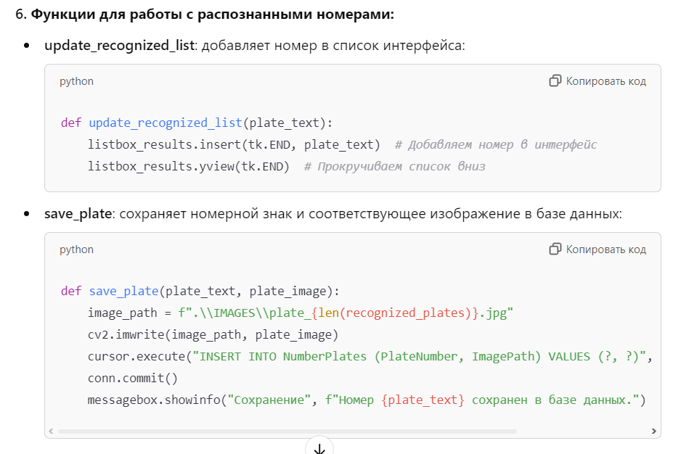

Slide 18
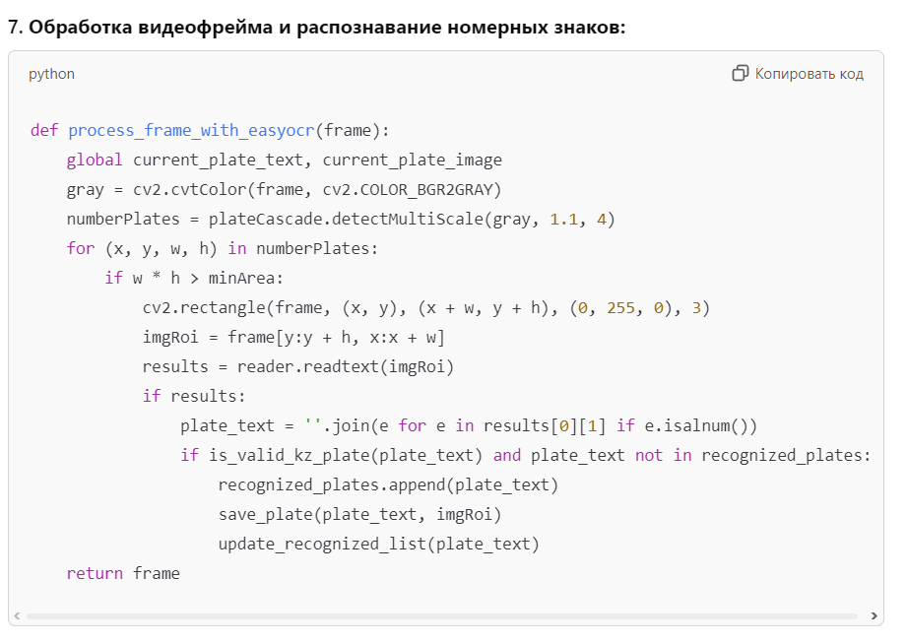
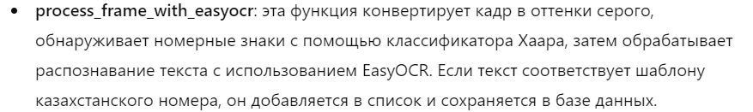

Slide 19
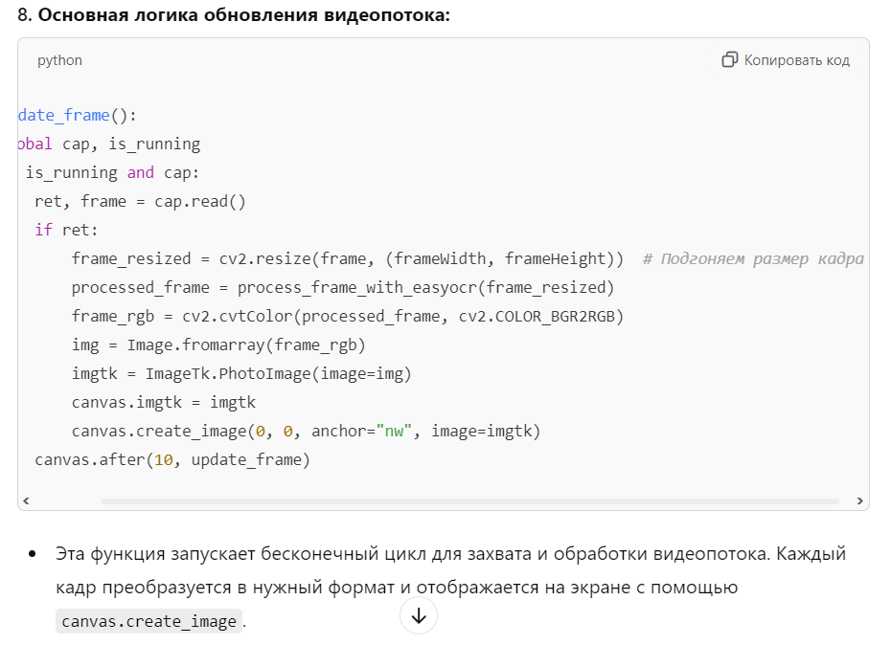

Slide 20
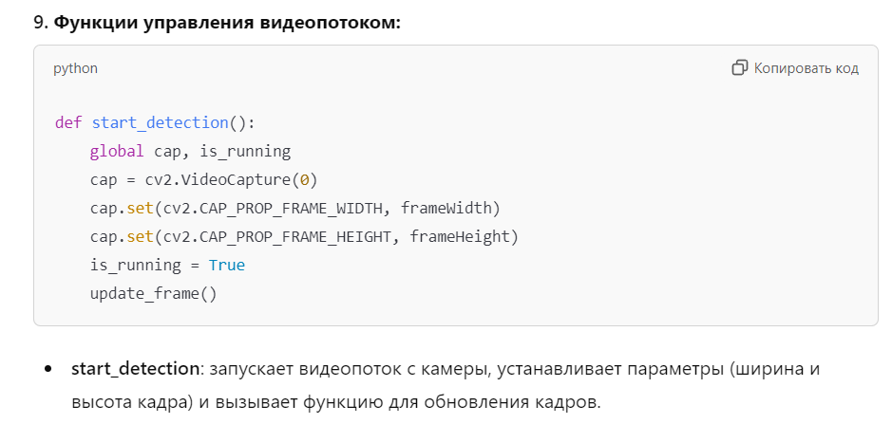

Slide 21
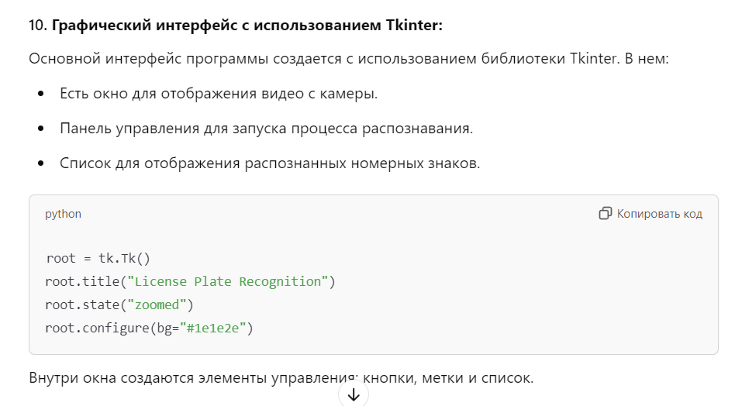

Slide 22
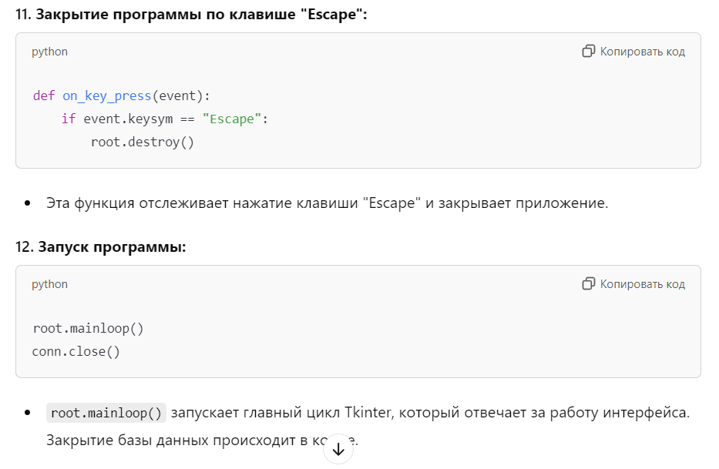

Slide 23
Summary
The program recognizes car license plates in real time from a camera video stream. It uses OpenCV for video capture and sign detection, EasyOCR for text recognition, and saves the results in a SQL Server database.
During the operation, the user can see the recognized numbers in a list and save them along with the image in the database. The intuitive graphical interface makes it easy to interact with the application.

Slide 24
Reflexion
1- Technology and Integration
The technologies used to build the application are:
OpenCV for video stream capture and license plate detection using Haar classifier.
EasyOCR for recognizing text from images.
Tkinter for creating a graphical interface.
SQL Server and PyODBC for storing data in the database.
2. Achievements
Video Capture: Video stream from camera is updated and processed in real time.
License plate recognition: License plates are recognized and added to the interface.
Database: Recognized license plates and images are stored in a SQL Server database.
Interface: Simple and straightforward operation.
3. Improvements
Recognition accuracy: You can improve accuracy using neural network methods (e.g. YOLO).
Video Management: Optimize frame rate and video quality.
Interface: Add new features and improve interface dynamism.
Error handling: Need to add error handling to improve the robustness of the application.
4. Conclusion
The project has demonstrated effective use of technology to create a license plate recognition application. There is room for improvement in accuracy and interface, but the application is already stable.

